Slide 1

Credit Card Cluster Analysis
Andrew Thomas Joshua Gaze Phong Ong Sophea Hummel

Slide 2

Project Objectives
Understand various usage behaviors of credit card holders across a large population
Learn the habits of payment cadence and amounts to understand the level of impact it has one’s credit

Slide 3
Data Overview
Variable | Description
CUSTID | Identification of Credit Card holder (Categorical)
BALANCE | Balance amount left in their account to make purchases
BALANCEFREQUENCY | How frequently the Balance is updated, score between 0 and 1 (1 = frequently updated, 0 = not frequently updated)
PURCHASES | Amount of purchases made from account
ONEOFFPURCHASES | Maximum purchase amount done in one-go
INSTALLMENTSPURCHASES | Amount of purchase done in installment
CASHADVANCE | Cash in advance given by the user
PURCHASESFREQUENCY | How frequently the Purchases are being made, score between 0 and 1 (1 = frequently purchased, 0 = not frequently purchased)
ONEOFFPURCHASESFREQUENCY | How frequently Purchases are happening in one-go (1 = frequently purchased, 0 = not frequently purchased)
PURCHASESINSTALLMENTSFREQUENCY | How frequently purchases in installments are being done (1 = frequently done, 0 = not frequently done)
CASHADVANCEFREQUENCY | How frequently the cash in advance being paid
CASHADVANCETRX | Number of Transactions made with "Cash in Advanced"
PURCHASESTRX | Number of purchase transactions made
CREDITLIMIT | Limit of Credit Card for user
PAYMENTS | Amount of Payment done by user
MINIMUM_PAYMENTS | Minimum amount of payments made by user
PRCFULLPAYMENT | Percent of full payment paid by user
TENURE | Tenure of credit card service for user
Around 9,000 Active Credit Card Holders over a 6-month period
8,950 records across 18 attributes
Datasource Located on Kaggle

Slide 4
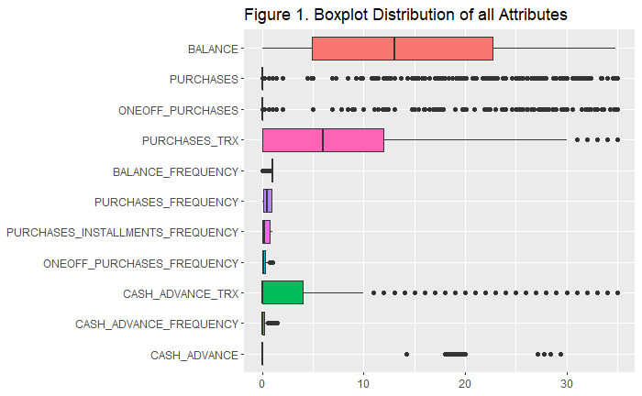
Exploratory Data Analysis
Variables have a positively skewed distribution
Balance is the exception with only slight positive skewness
Outliers were kept in the dataset

Slide 5
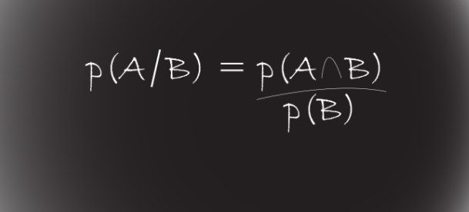
Naïve Bayes Attempt
Algorithm was attempted to see if additional insight could be brought in and provide further insight
Output did not seem logical or conducive given the nature of the dataset
Results were way off compared to the approximate balances ~Predictability with this approach did not seem to make sense to the team

Slide 6

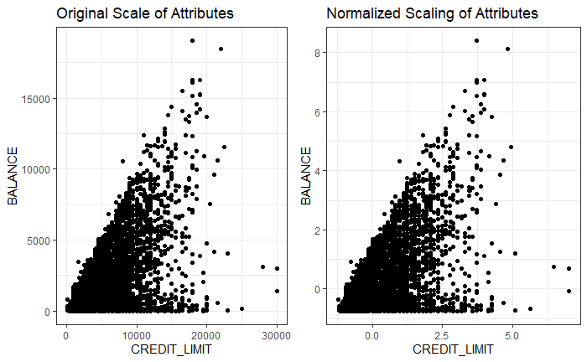



Data Preprocessing

Slide 7
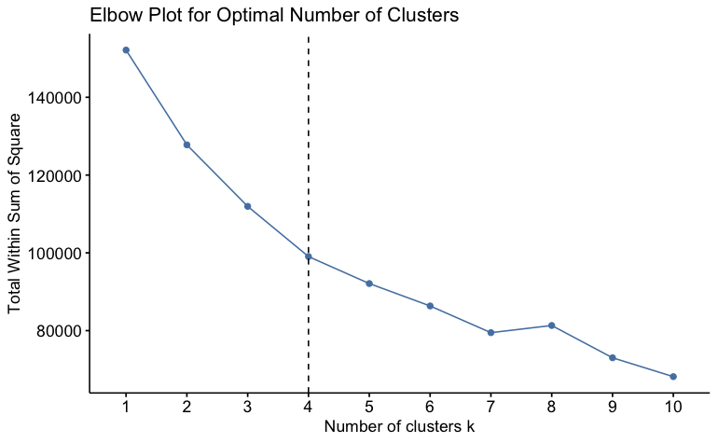
K-Means
“Elbow-plot” aided us in assessing the optimal number of clusters to utilize for K-Means
This approach appropriately segments the bank’s cardholders.

Slide 8
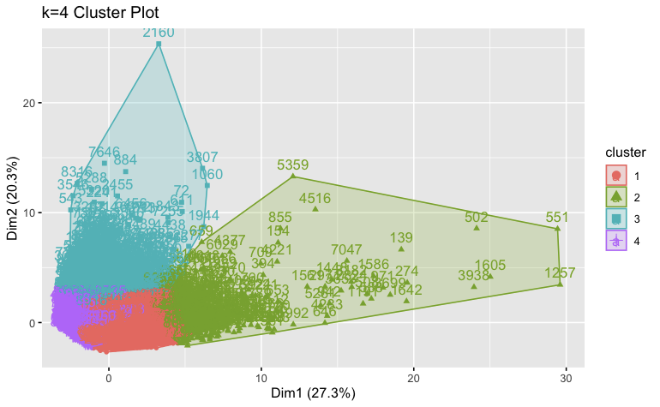
K-Means

Slide 9
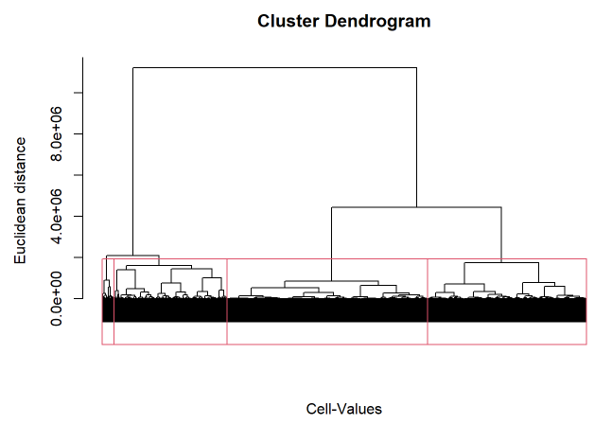
Hierarchical Clustering
The dendrogram clusters evolved from ward method
Characteristic fiscal behaviors are derived from the cluster model
Groupings are determined on these similar behaviors

Slide 10
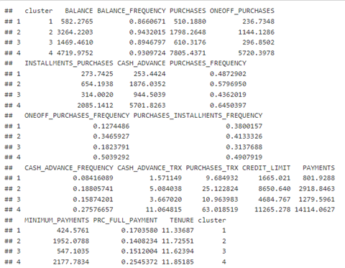
Average Values of Attributes in Clusters

